Slide 1
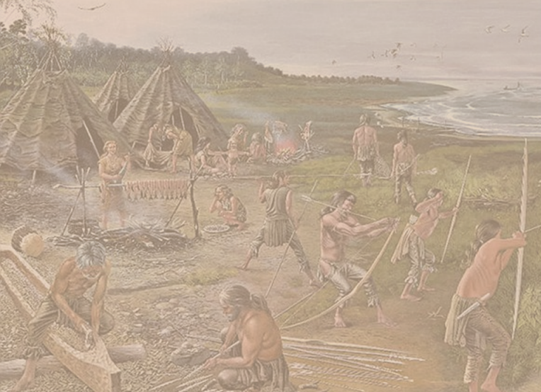

The Stone Age story of Liverpool
and surrounding areas.

Slide 2
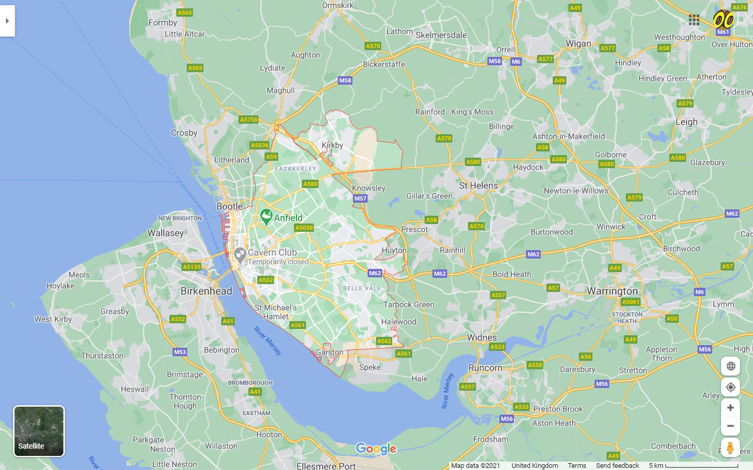
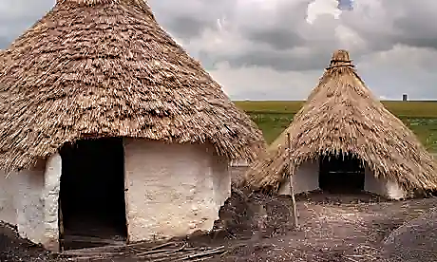
Lunt Meadows
Near Crosby
At Lunt Meadows near Crosby
evidence of stone-age huts has been found.

Slide 3
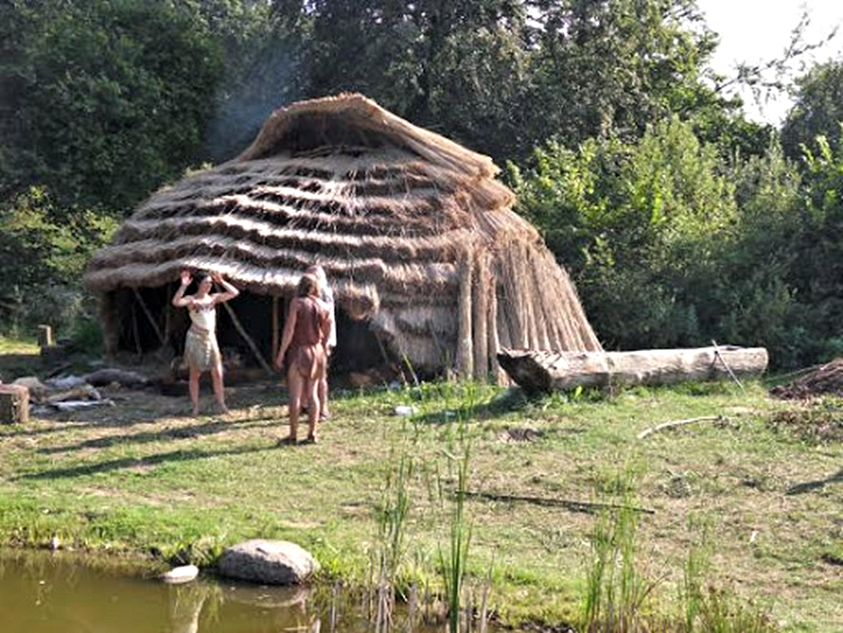
There is evidence suggests a small tribe of people lived here during the Neolithic Period.

Slide 4
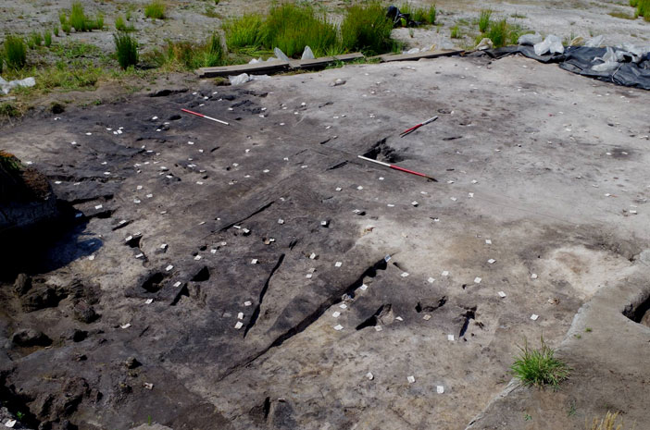
This shows burnt markings at the Crosby site
where stone-age fires would have been.

Slide 5
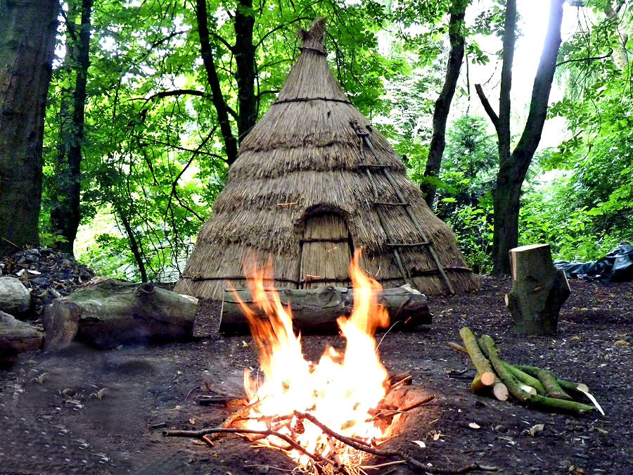
This is how their huts and fire could have looked.

Slide 6
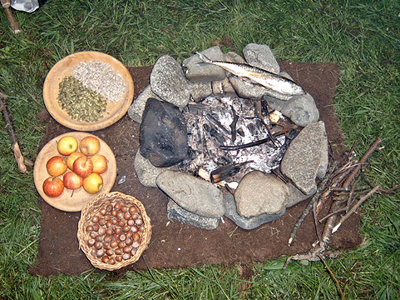
Stone Age people would have moved around a lot. Eating food as they found it.

Slide 7
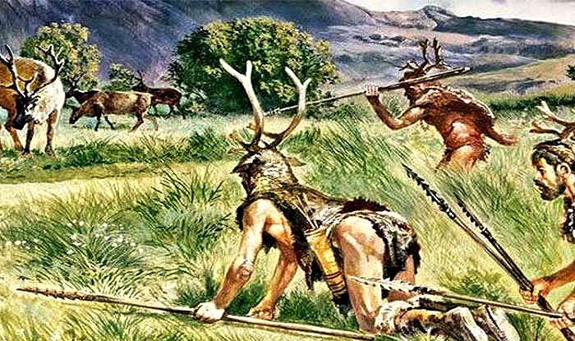
There were lots of deer
in the Liverpool area at this time.

Slide 8
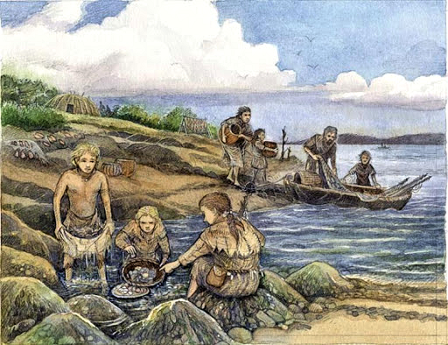
Stone Age people would have fished
in the River Mersey for food.

Slide 9
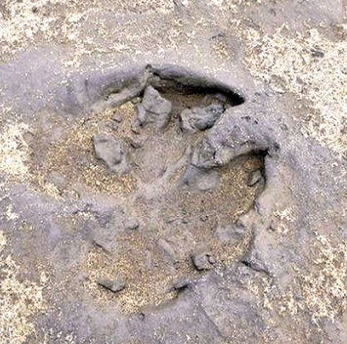
Footprints
at Formby
On Formby Beach there are hundreds
of Stone age footprints.

Slide 10
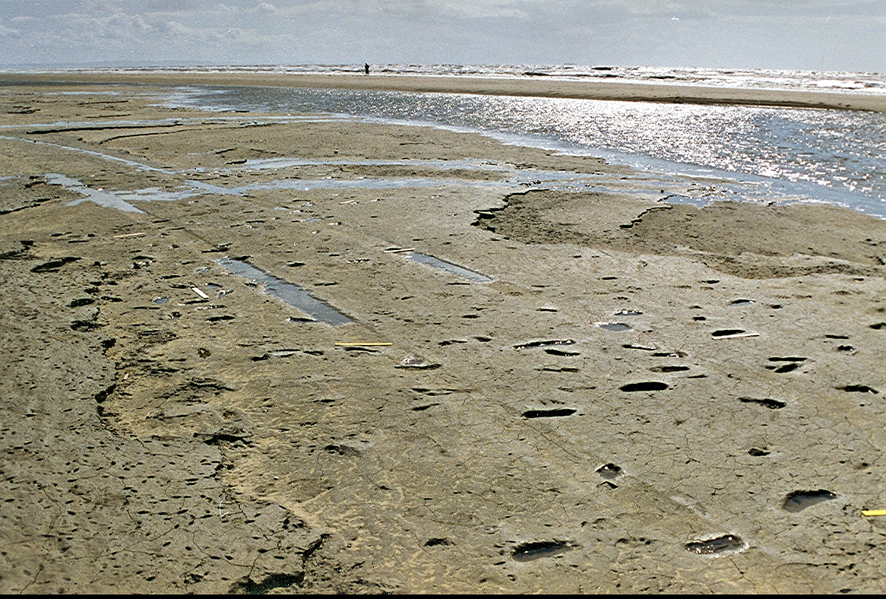
5000 year old footprints appear and disappear with passing tides.
Each day will reveal different prints.

Slide 11
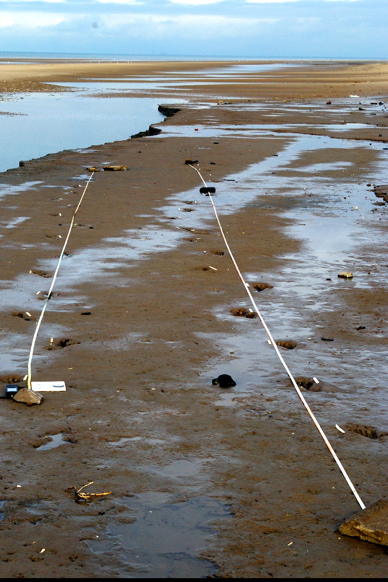
The size of each footprint and the distance between them can tell the rough age of the person and also if they were walking or running.

Slide 12
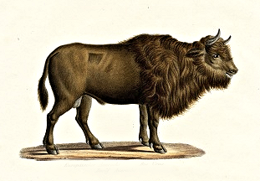
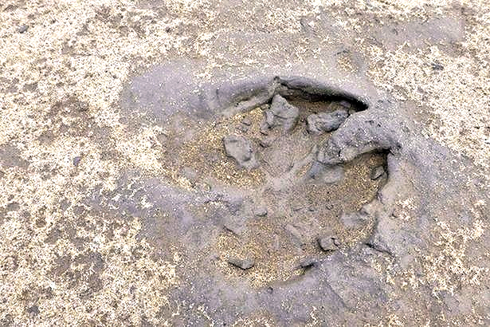
There are footprints of deer, dogs, wolves and
extinct animals like the Auroch.

Slide 13
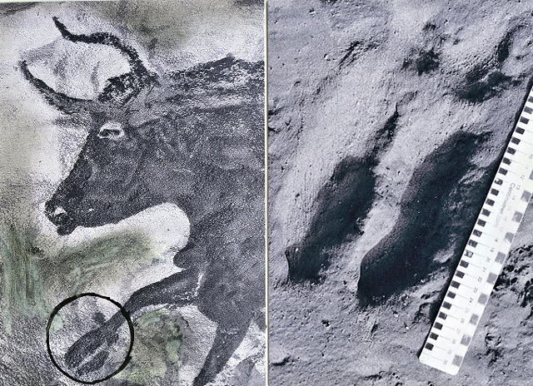
Cave paintings of a Auroch
match the footprints found at Formby.

Slide 14
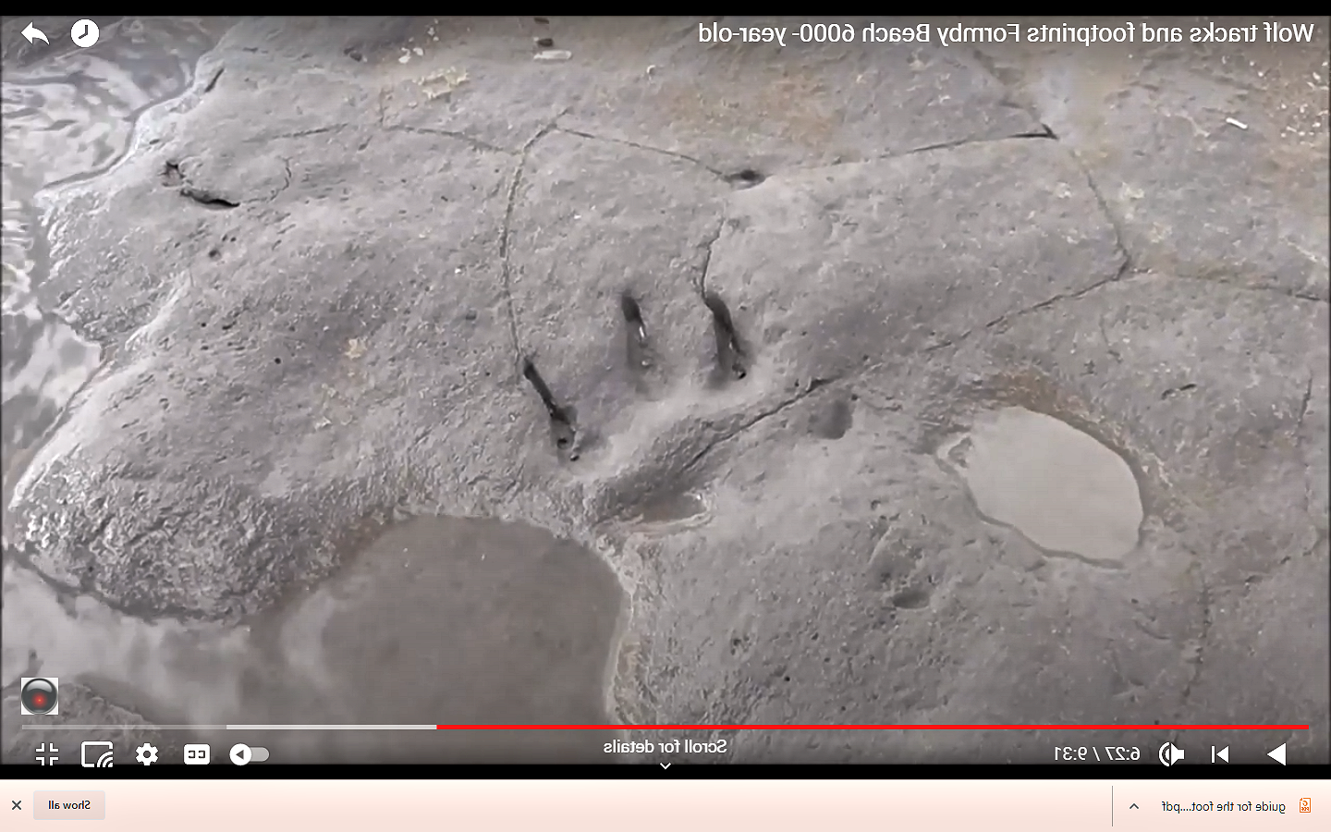
Bear footprints.
There is also evidence that the area that is now Formby Beach once had trees growing on it.

Slide 15
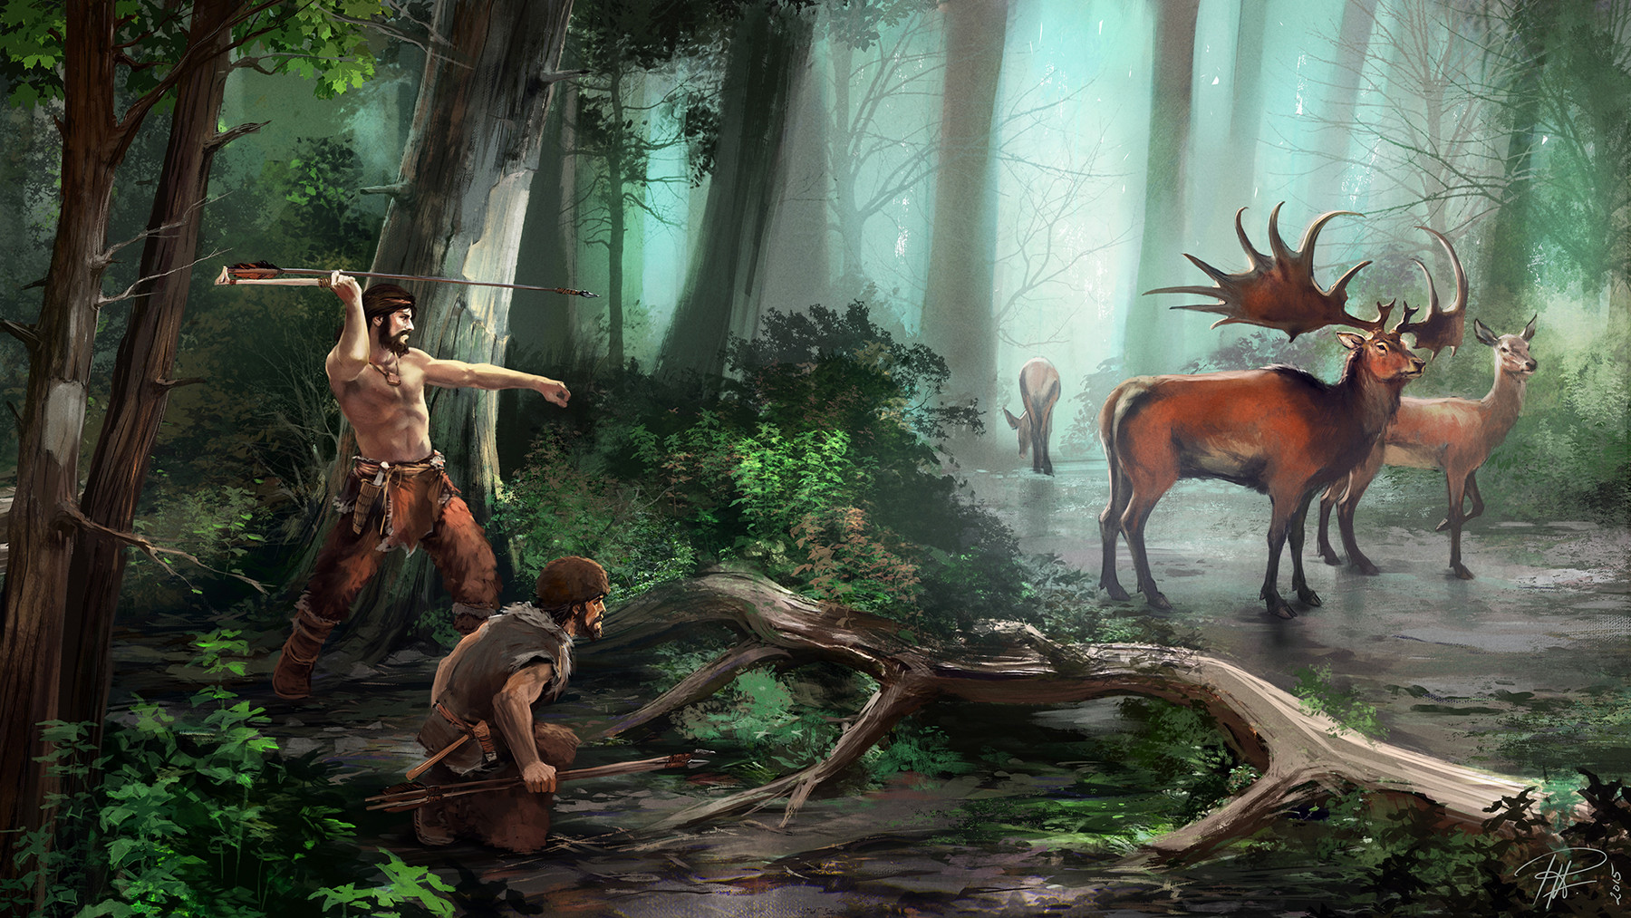
This is how Formby beach could have looked 5000 years ago. Before the sea levels rose and flooded the whole area.

Slide 16
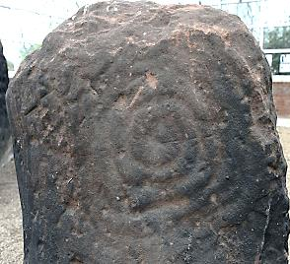
Calder Stones
Allerton
In Allerton there was once a
Neolithic Burial Chamber

Slide 17
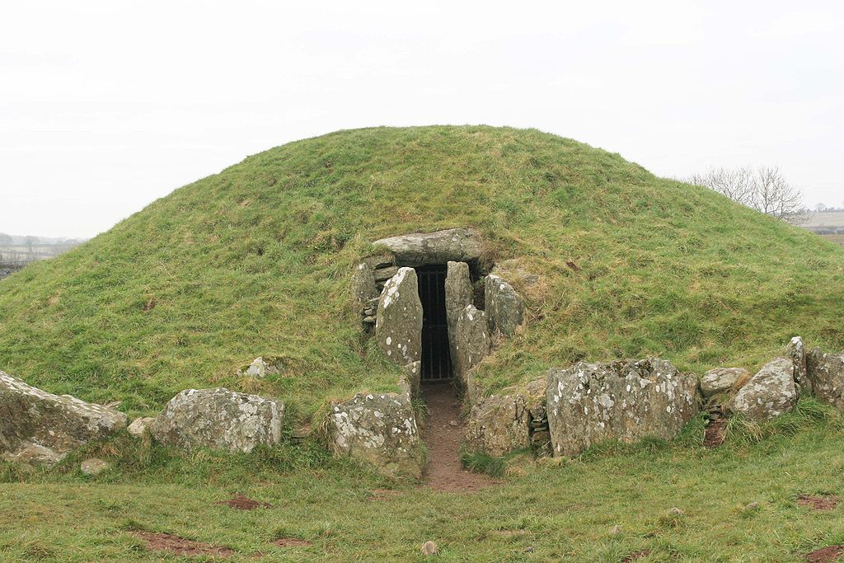
The chamber probably looked like this with large sandstone stones around it.

Slide 18
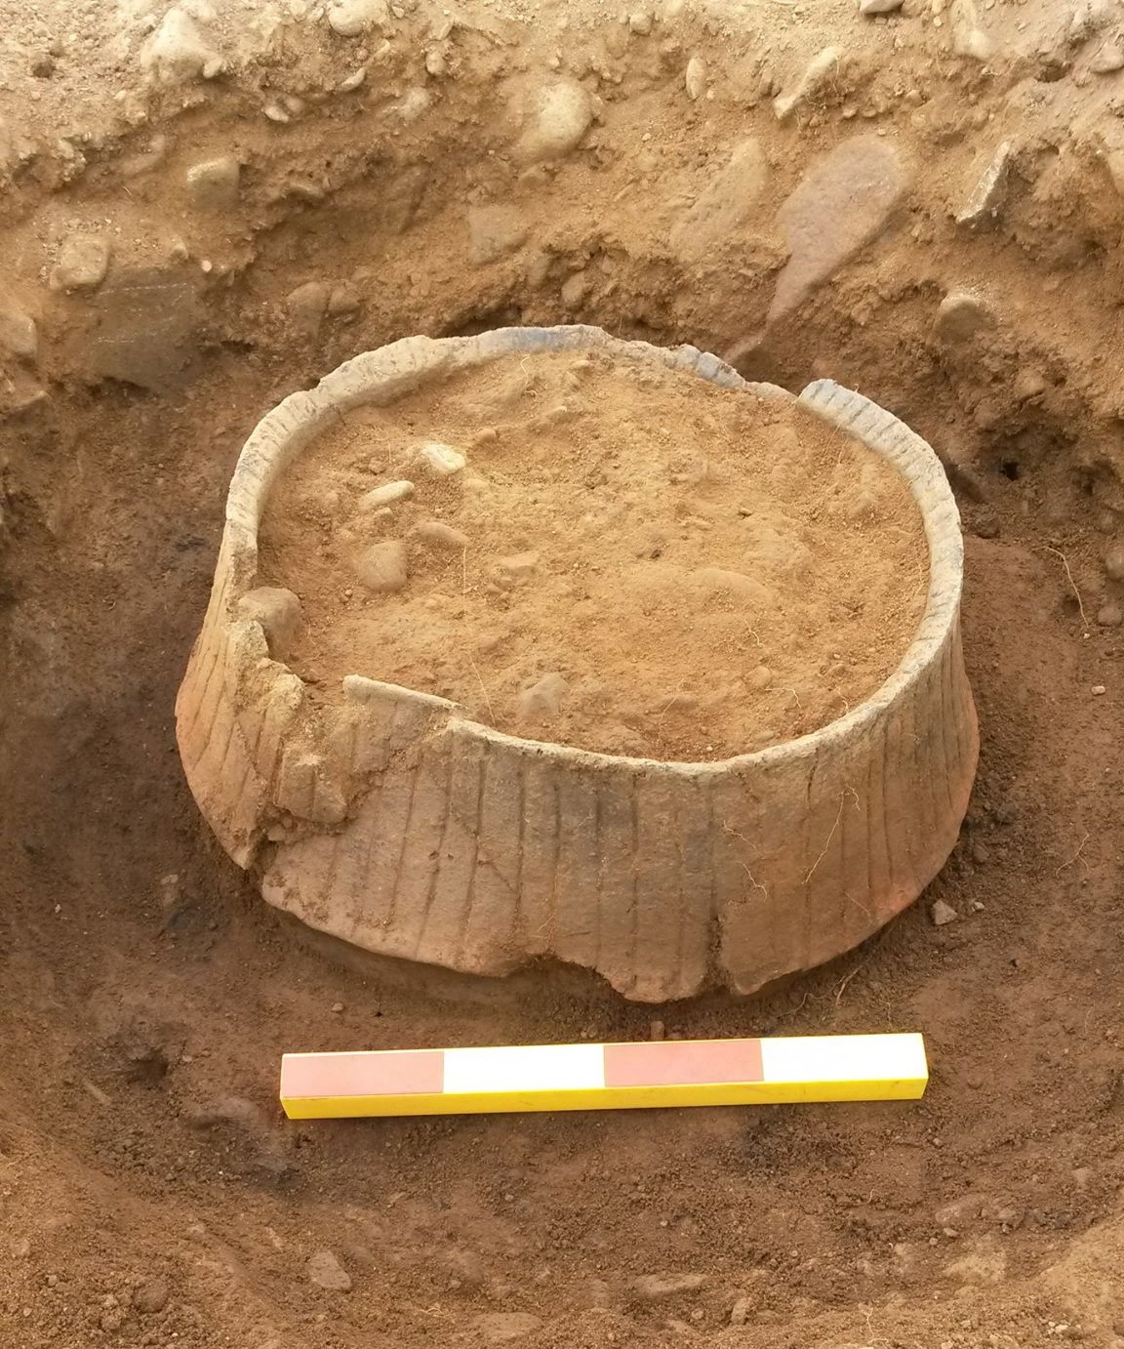
There are written records that a (now lost) burial cremation ‘pot’ with dust and bones
was found by the Calder Stones

Slide 19
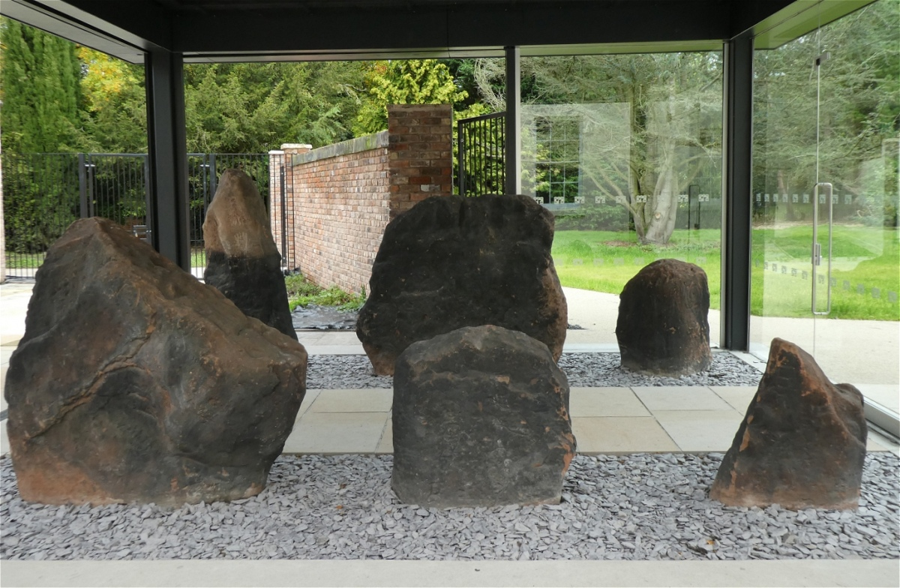
There are six Calder Stones
that remain at the site today.

Slide 20
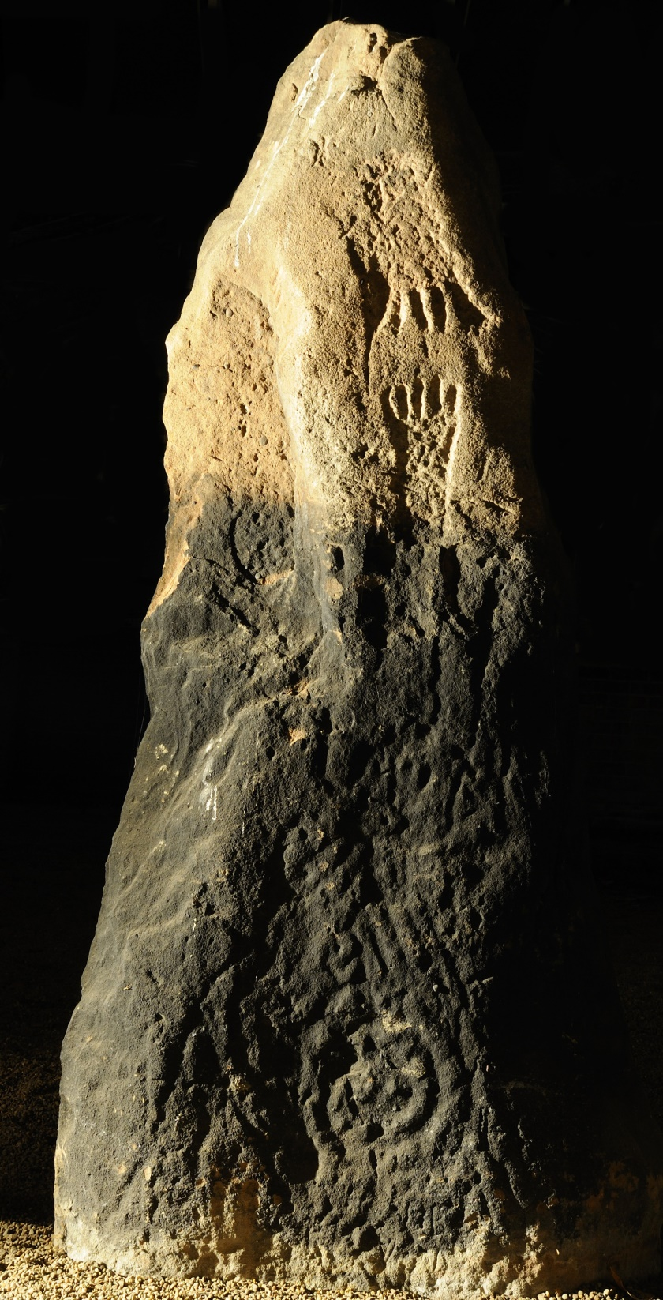

These photos show the strange markings carved into the 5000 year old Calder Stones.

Slide 21
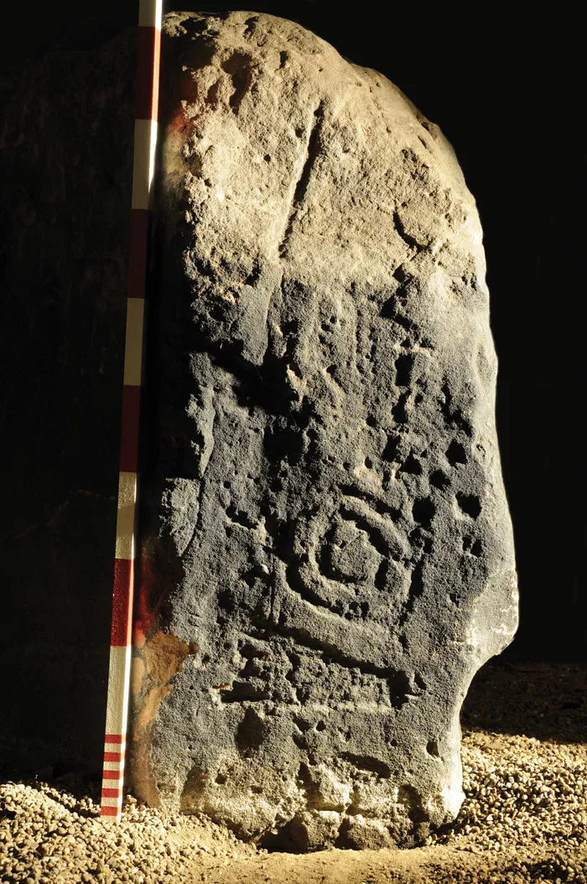
Footprints, circles and 5 dice dots
were also carved in by Stone Age people.

Slide 22
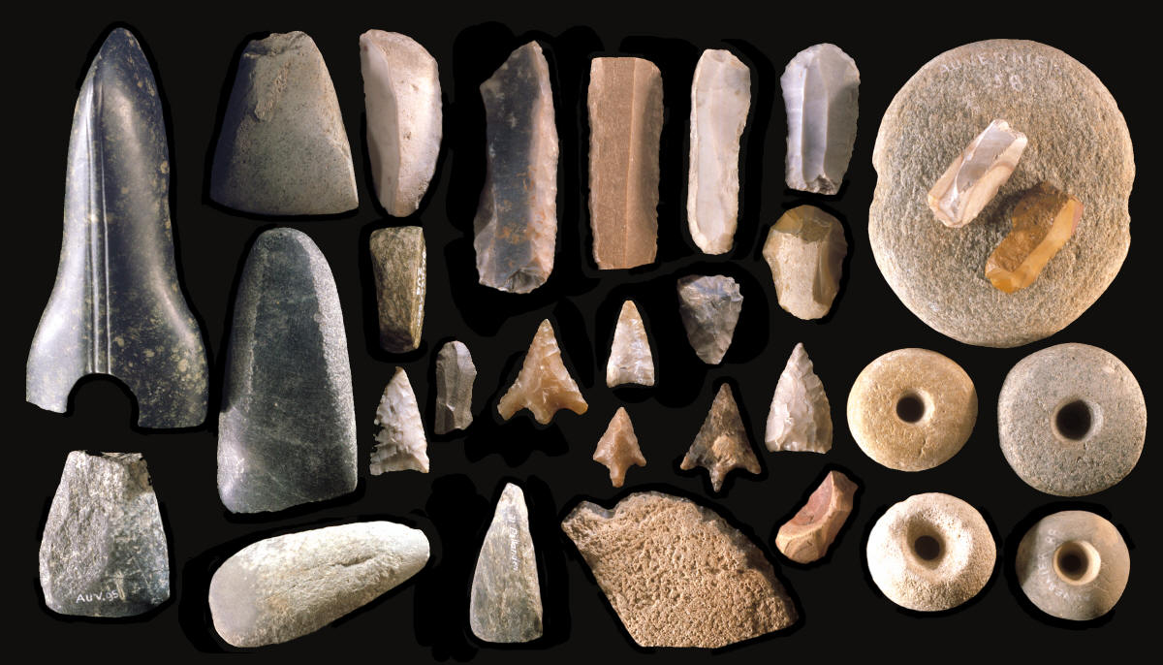
Stone-age tools flint tools found in the area all all connected by one thing…

Slide 23
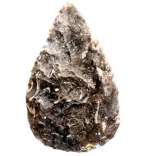
The stones have all been found along the line of the River Alt which flows from Formby to Widnes.
Formby
Crosby
Croxteth
Huyton
Speke

