Slide 1
Cave Art
Lesson Notes
Each proceeding slide has the cave art enlarged
Each painting is followed by a picture to show
what the painting represents in real life
The final slide is a printable worksheet

Slide 2
What does this cave painting show?
Why was it important for Stone Age People?

Slide 3
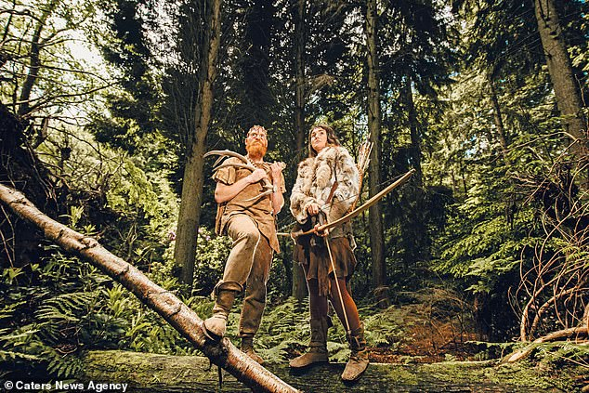
Trees gave people wood for fire
fruit, nuts and berries for food.

Slide 4
What does this cave painting show?
Why was it important for Stone Age People?

Slide 5
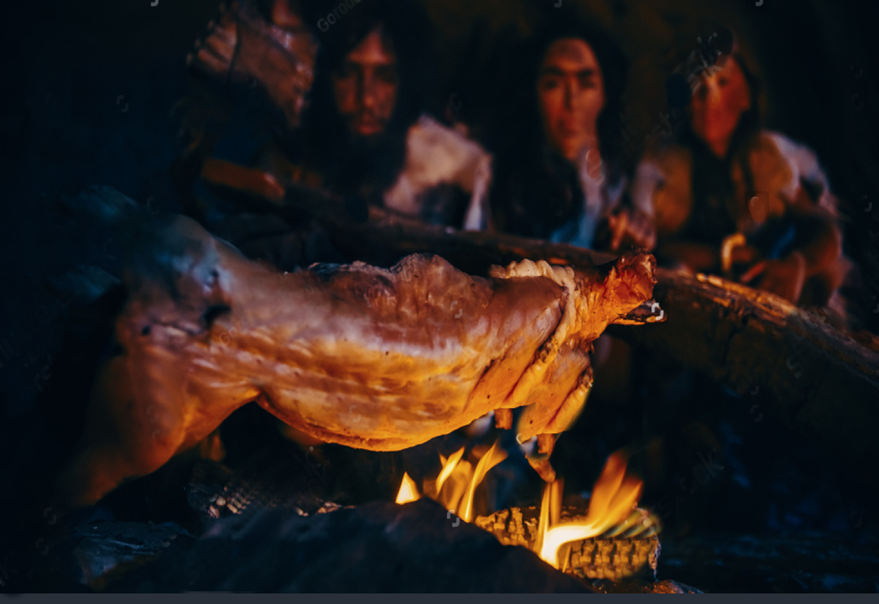
Roasting animals gave people food
and their skins were used as clothing.

Slide 6
What does this cave painting show?
Why was it important for Stone Age People?

Slide 7
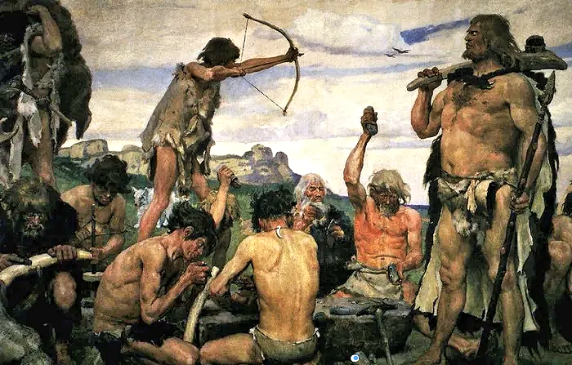
Arrows fired from a bow could
kill an animal far away.

Slide 8
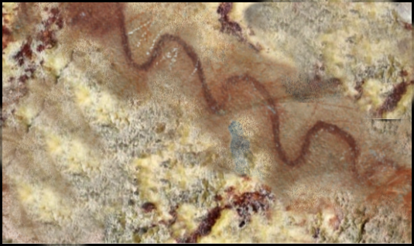
What does this cave painting show?
Why was it important for Stone Age People?

Slide 9
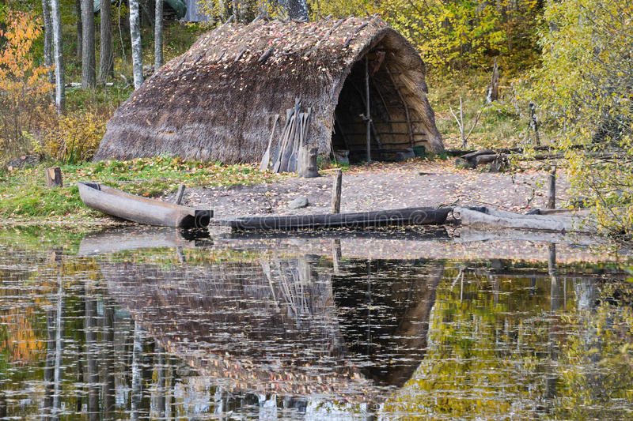
Stone Age huts near water
allows people to drink and catch fish.

Slide 10
What does this cave painting show?
Why was it important for Stone Age People?

Slide 11
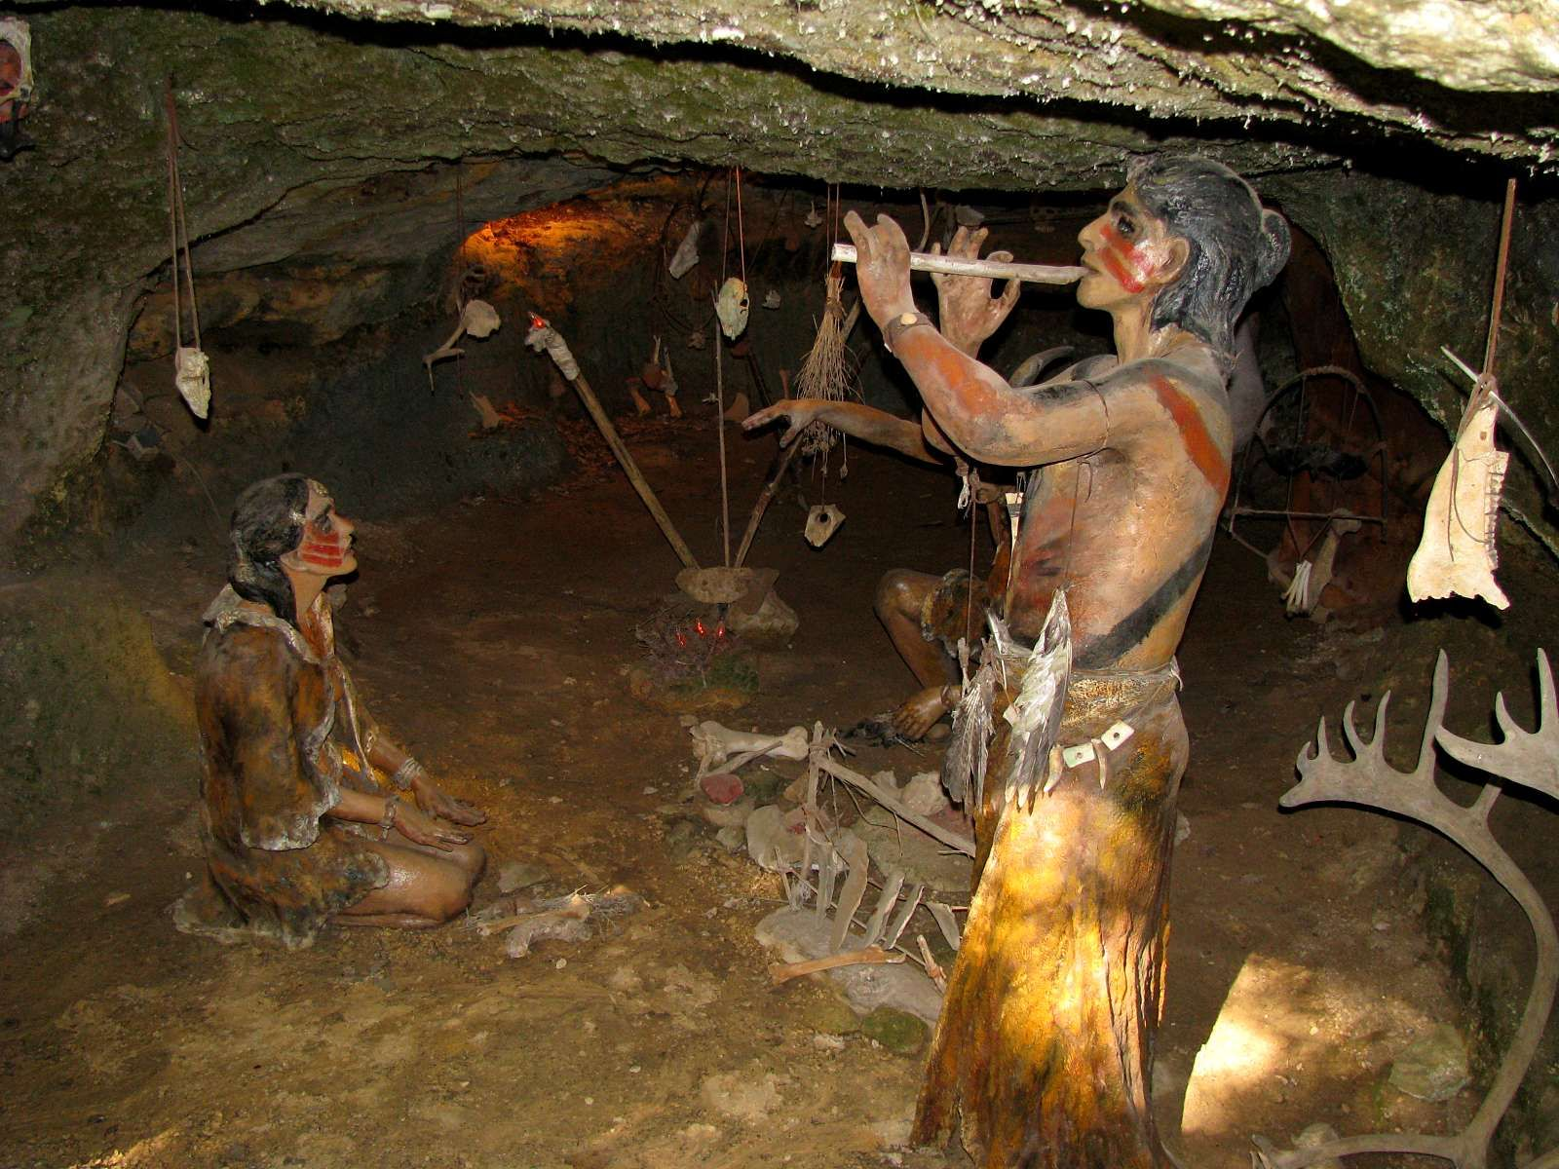
Dancing and playing music
was part of Stone Age worship.

Slide 12
What does this cave painting show?
Why was it important for Stone Age People?

Slide 13
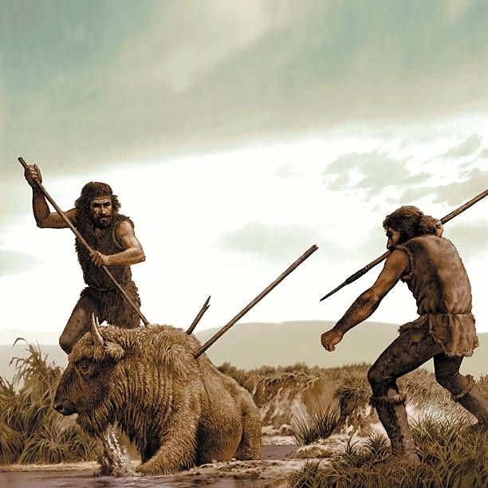
Spears allowed people to kill animals

Slide 14
What does this cave painting show?
Why was it important for Stone Age People?

Slide 15

The sun was worshiped because
it brought warmth, light, helped with directions, the time of day and allowed things to grow.

Slide 16

What has been drawn on the wall?
And why was each thing important to Stone Age People?

